Slide 1
Selected topics in JavaScript

Slide 2
Agenda
How java script work

Slide 3
How JavaScript work?
First should explain some terminology should know to get what I say next
synchronous and asynchronous
Synchronous: operations tasks are performed one at a time and only when one is completed, the following is unblocked. In other words, you need to wait for a task to finish to move to the next one.
Asynchronous: operations, on the other hand, you can move to another task before the previous one finishes.

Slide 4
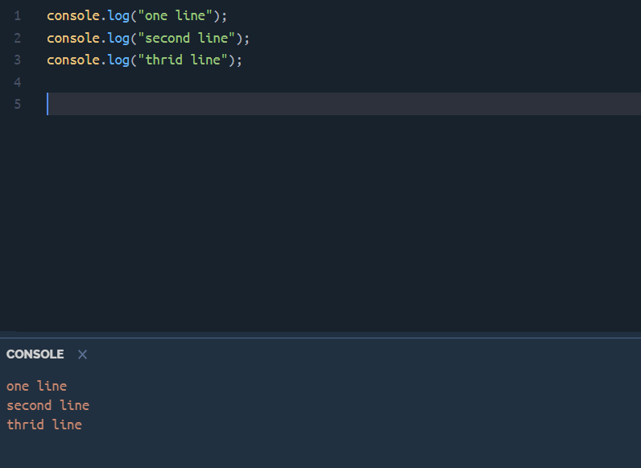
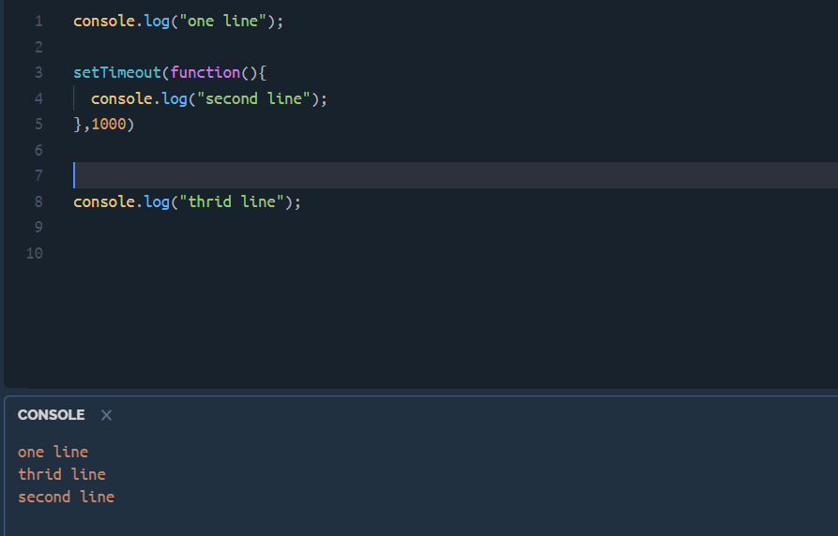
Synchronous | Asynchronous

Slide 5
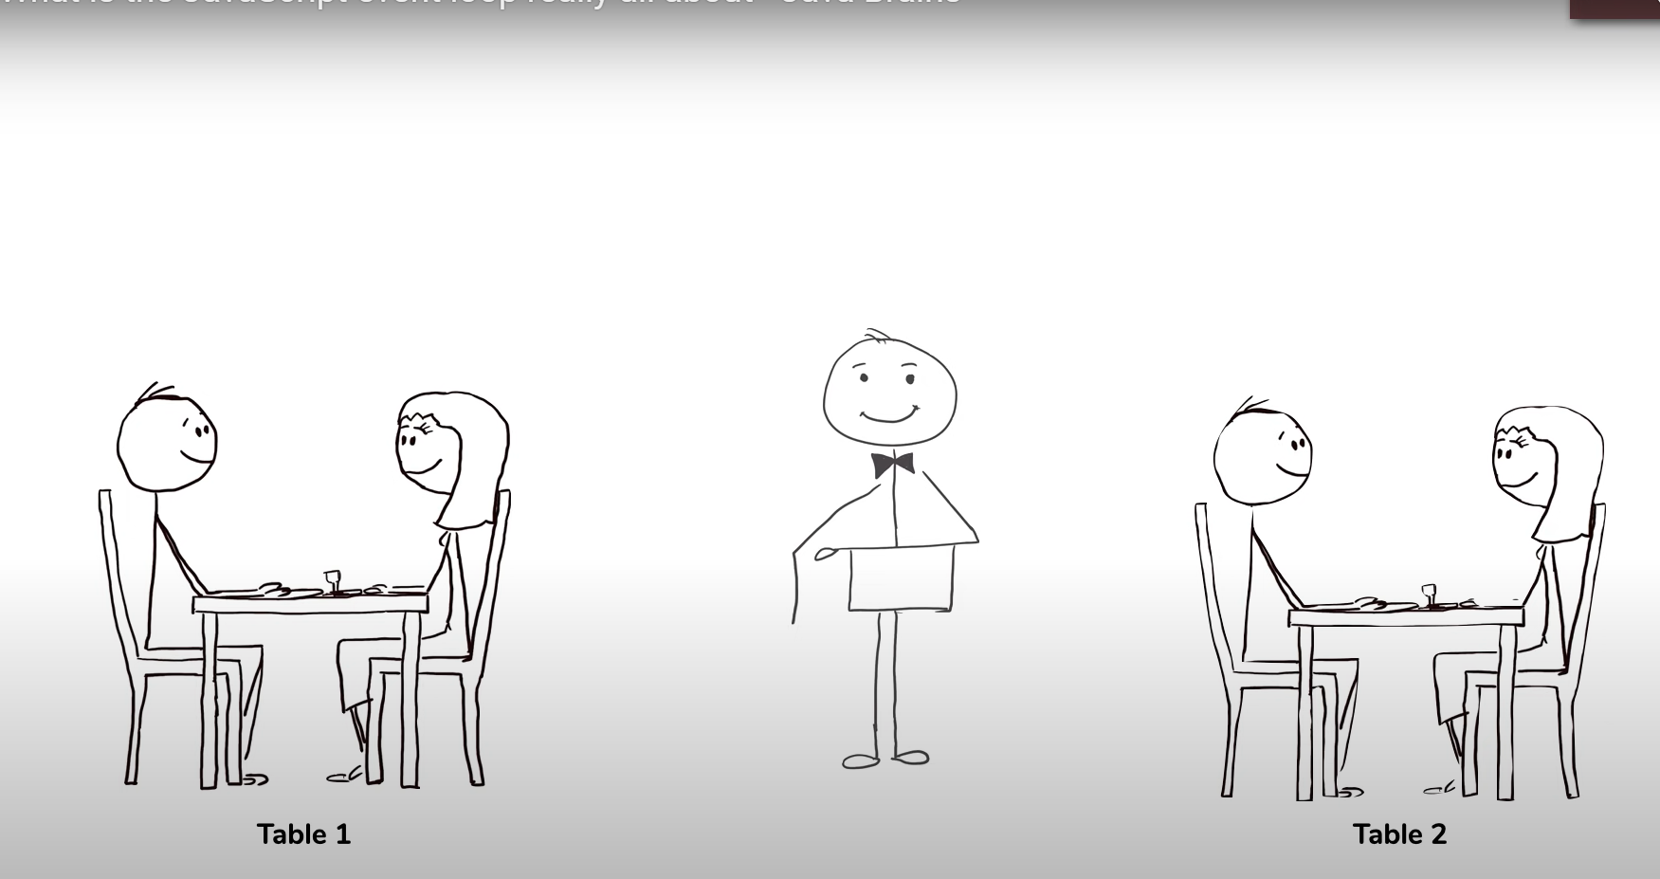
Single thread vs. multi thread

Slide 6
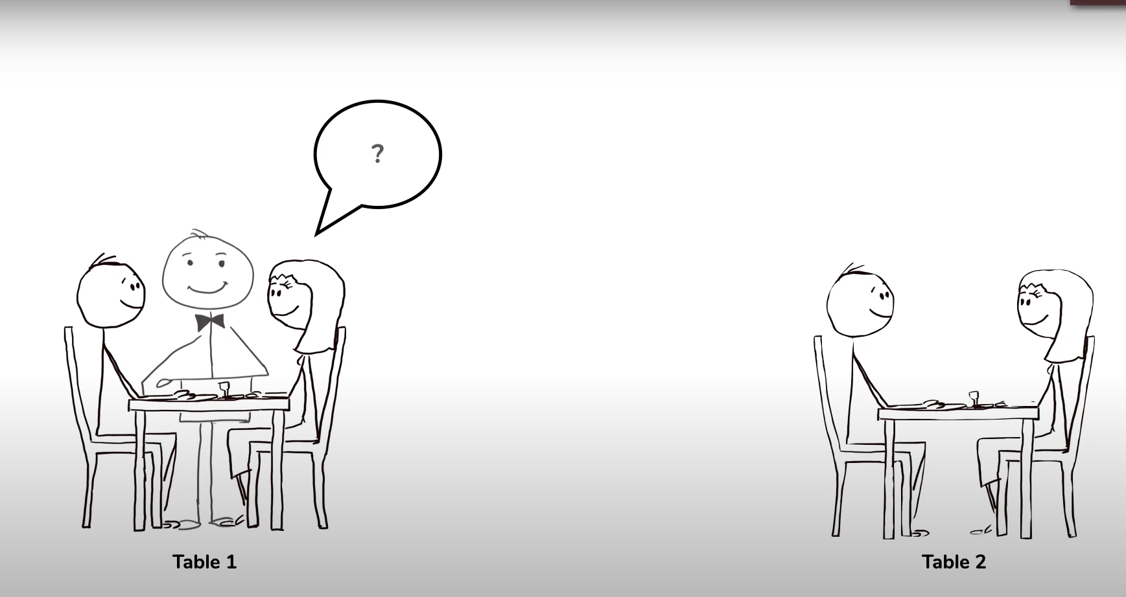
Single thread vs. multi thread

Slide 7
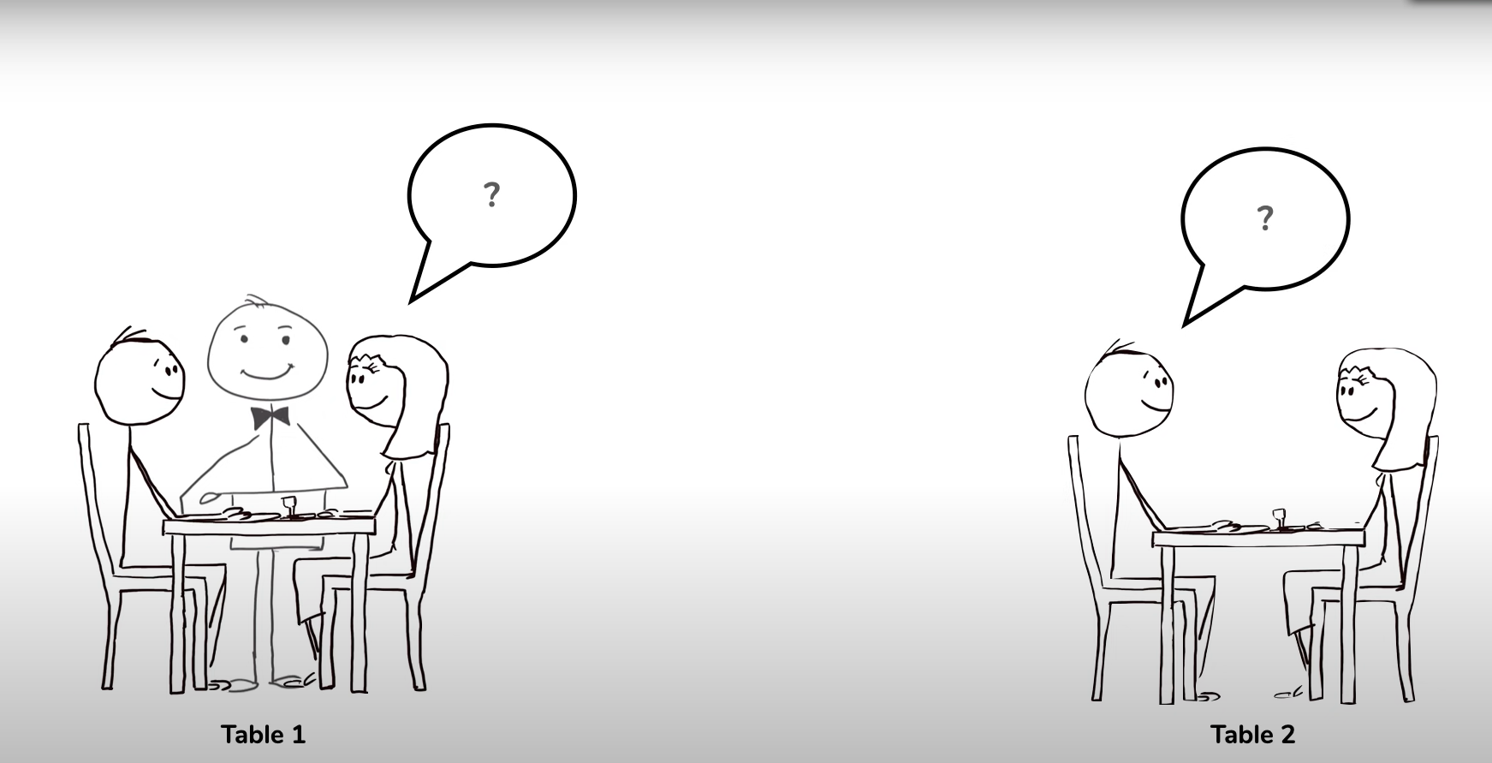
Single thread vs. multi thread
Problem???

Slide 8
Event loop in JavaScript
Event loop structure:
Call stack
WebApis
Callback queue
Event loop

Slide 9
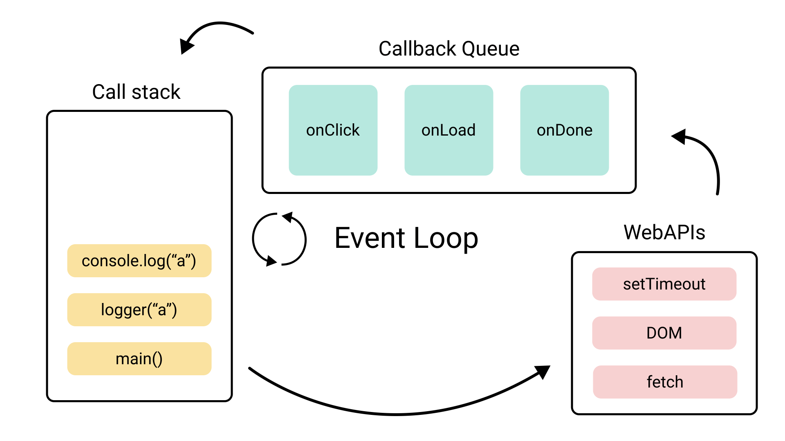
Event loop in JavaScript

Slide 10
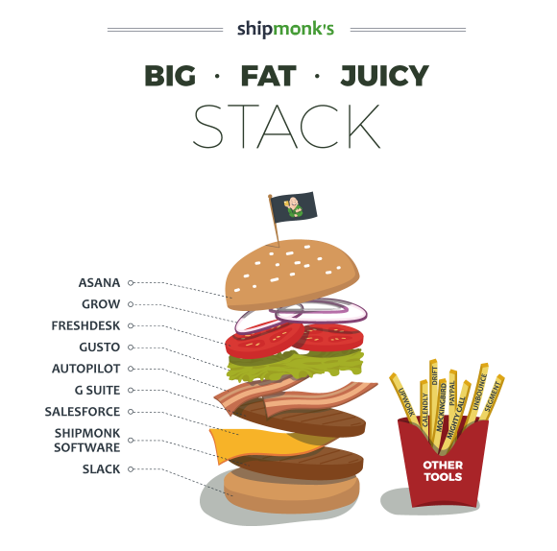
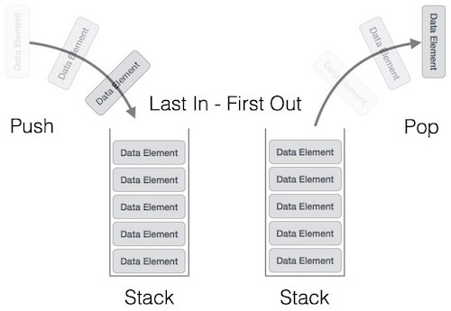
Call stack

Slide 11
Call stack
Call stack is provided by JavaScript runtime (V8 for example).
As a single threaded programming language JavaScript has only one call stack.
This means that only one thing can be executed at a time.
Call stack is simply a place where these executable contexts are placed in order for getting executed.
Call stack follows the LIFO principle (Last In First Out).

Slide 12
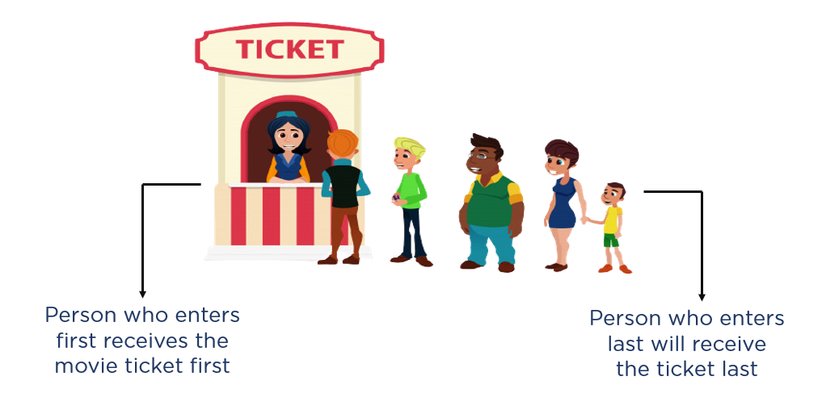
Callback queue

Slide 13
Event loop
WebAPIs are APIs provided by the browser.
They kind of work as an artificial extra threads and allow us to execute multiple things at the same time for certain cases.
Callback queue is a queue where callback functions gets pushed from the WebAPIs once they have finished.
The Event Loop has only one simple job to do. It looks at the Call Stack and Callback Queue, if the Call Stack is empty, it pushes the first callback function of the Callback Queue to the Call Stack.

Slide 14
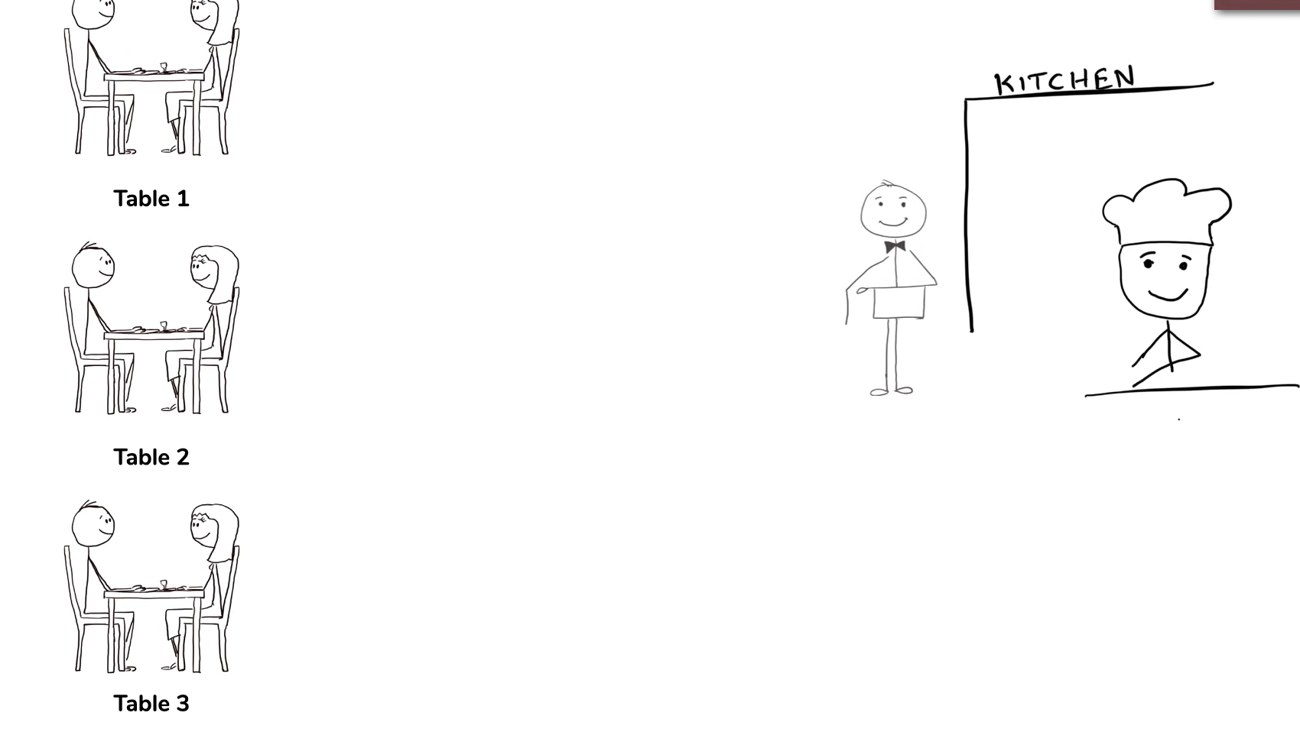
Event loop

Slide 15
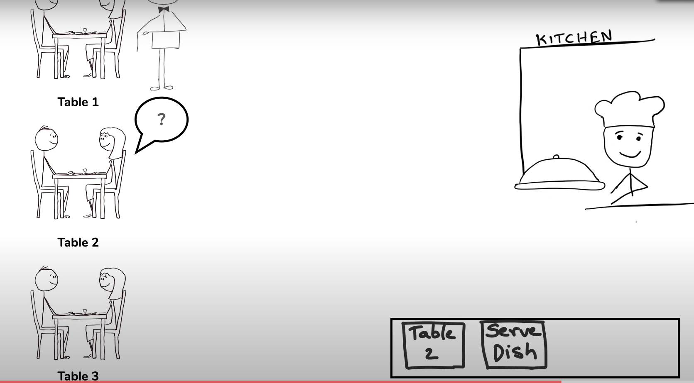
Event loop

